Slide 1
Introduction To Kotlin

Slide 2
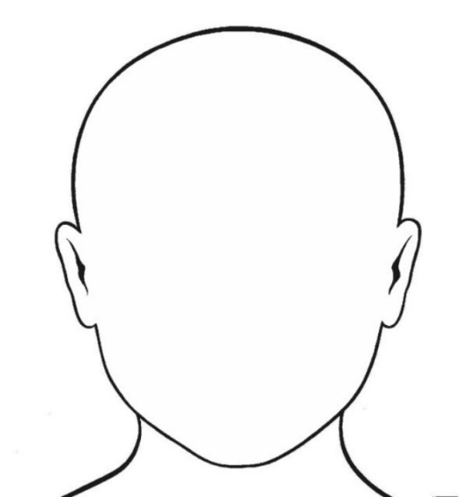
Introduction
Bartek Kuczyński
Bkuczynski@luxoft.com
http://luxoft-training.pl
http://luxoft-training.com

Slide 3
Training Roadmap: OVERVIEW
Motivation | 5
Basic elements | 17
Classes and Interfaces | 43
Functions | 50
Data Classes | 62
Operators | 77
Extensions | 101
This training covers major aspects of Kotlin language. The goal of this training is to recognize basic concepts and .
This training is targeted to java developers who would like to start to learn other language on JVM platform.
Pre-requisites:
Git client
Gradle 2+
Your favorite IDE

Slide 4
TRAINING ROADMAP: STRUCTURE
8 Hour sessions
15-30 mins breaks every 1.5 – 2 hours
Lunches (take your lunch card)
In-class individual practice
In-class group workshops
Homework

Slide 5
Section 1: Bla-bla & Bloo-Bloo

Slide 6
Slide Title: Subtitle

Slide 7
Color Gamma

